Slide 1

Capstone: LaSalle Consulting BI Solution
Collin Schaefer
MIS 480: Business Analytics & Information Systems
CSU – Global
Dr. Steve Chung
January 16, 2022

Slide 2

Introduction to Lasalle Consulting
It is a technology consulting firm established in 1992 before it was strictly an accounting firm.
LaSalle Consulting is a private company headquartered in Chicago, Illinois.
The size of the organization consists of multiple branches with between 15-20 employees.
It has subsidiaries in India and the Philippines, along with branches New York City and Charleston.
The company specializes in consulting with labor unions.
With a recent investment into cybersecurity programs, the company is quickly expanding.

Slide 3

Reasons for selecting Lasalle consulting
The main reason for choosing LaSalle Consulting is its history of passion for delivering exceptional results to its clients within the community using technology.
The industries that LaSalle Consulting works with are typically behind on technology, giving LaSalle an edge on bringing them up-to-date.

Slide 4

Cont.
With a new focus on technology, LaSalle Consulting has found a great opportunity in the security field of technology.
They realized that their clients work with PHI and PII on a daily basis, meaning they require strict security measures in place to protect this information.
By establishing a cybersecurity program, LaSalle Consulting is expected to grow substantially, granted they put in the marketing efforts to present their services.
By utilizing BI tools, LaSalle Consulting can determine what aspects of their marketing campaigns they can improve upon to become even more successful with their new services.

Slide 5

Business problem
Despite LaSalle Consulting being a well-established consulting firm, they currently lack growth in the expansion of their cybersecurity services.
This is both due to the lack of marketing strategies and data analytics.
By lacking strategy, solely relying on business references, LaSalle is missing out on a big opportunity to greatly expand their business in such a demanding field such as security.
There is not much data analytics being performed at the firm, meaning information is present, but may be inaccurate and should be analyzed/organized.

Slide 6

Data set choice
LaSalle Consulting gets their data from surveys in which clients state their reference along with marketing data from their web partners.
The datasets include revenue generated from various marketing referrals: radio, television, and social media.

Slide 7

Cont.
By counting the revenue generated by marketing strategies against their total revenue and profit, LaSalle Consulting can determine where their strongest opportunity for marketing their services may lie.
Data will be gathered in real-time through their monitoring system for their website in which they gather traffic along with client surveys tied to leads and completed contracts.
In this matter, it is important for LaSalle to re-allocate budgeting funds to their strongest points as some ways of marketing may not be profitable for them.
With the help of BI tools, LaSalle will be able to justify costs and marketing strategies appropriate for their cybersecurity services in order to capitalize on new business and growth.

Slide 8

BI Tools used for data analytics
Data and information are considered the most valuable assets to an organization as they help making important decisions for the future (Chugh, 2013).
Depending on execution, BI tools can not only be high-return, but high-risk as well for an organization. They can be expensive to implement and if not planned properly, it may not meet the goals of the business (Heinrichs & Lim, 2003).
One of the greatest benefits to come from BI tools in data analytics is the ability to have more accuracy in predictions of business decisions based on data.
Ultimately, good and organized data is what is going to lead to an even better BI solution.

Slide 9

Cont.
For this solution, both Tableau and SAS Studio were used for data visualization and analysis.
SAS is a statistical suite for complex analytics, business intelligence, and predictive analytics (SAS).
Tableau is a data analytics platform focused on visualization and reporting (Tableau).

Slide 10

Coding/ Functions
Most of the coding/functions came from SAS Studio as it is more code-oriented than Tableau.
The major differences between Tableau and SAS are the visualizations and analytic capabilities. With SAS being more advanced and requiring some coding skills which can be used to modify and create solutions.
To begin the data analytics process, PROC IMPORT was used to import a spreadsheet of the dataset being used for LaSalle Consulting which included revenue from radio, television, and social media.
Next histograms were created for each category to determine which generated the most revenue. This was performed with the PROC SGPLOT function, specifying histogram with the variable for each category.
Finally, a linear regression model was created to predict social media revenue based on influencer category using the PROC GLMSELECT function.

Slide 11
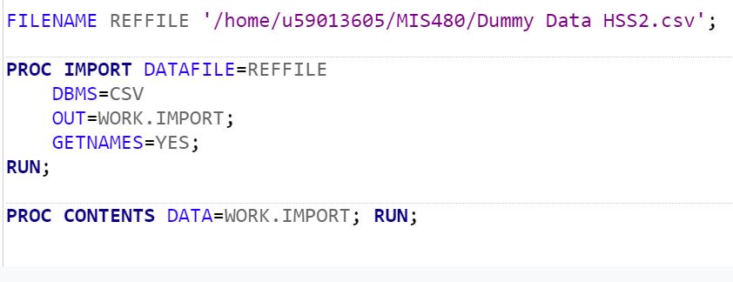
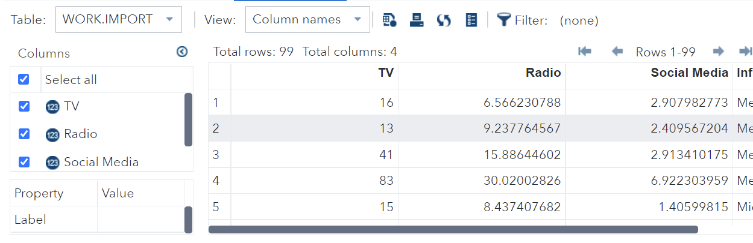
Cont.
Figure 1: Screenshot of Import Code and Output

Slide 12
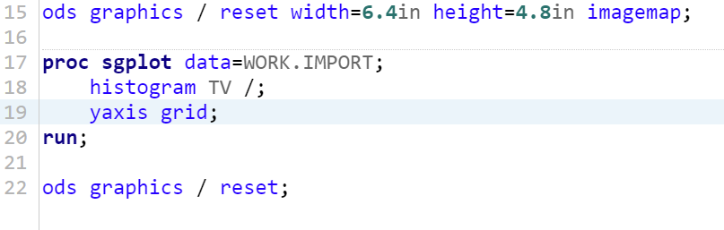
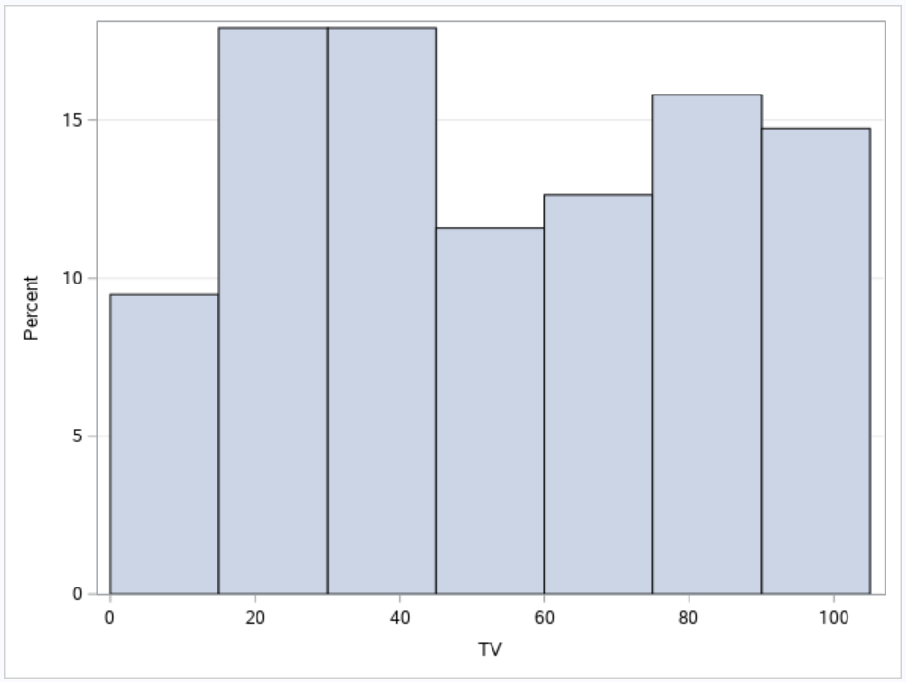
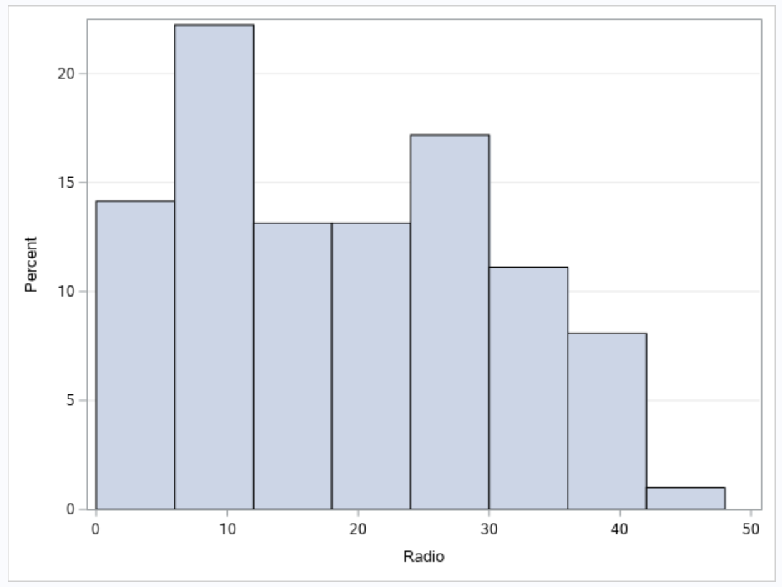
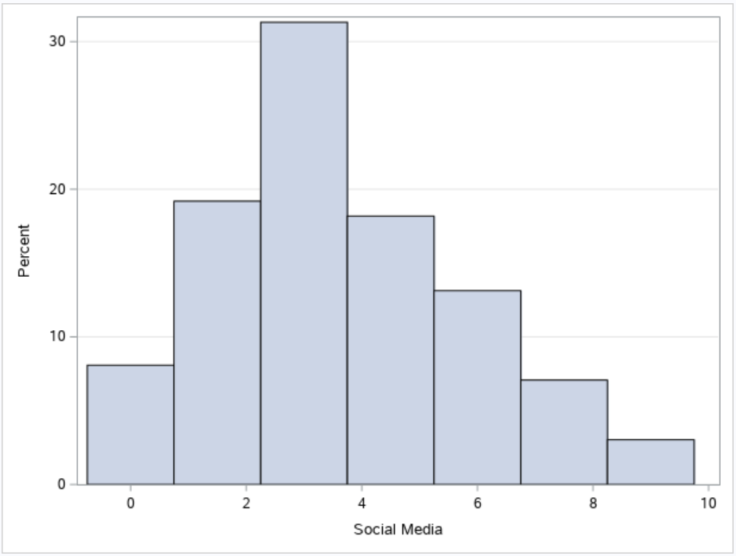
Cont.
Figure 2: Screenshots of Histogram Coding and Output

Slide 13
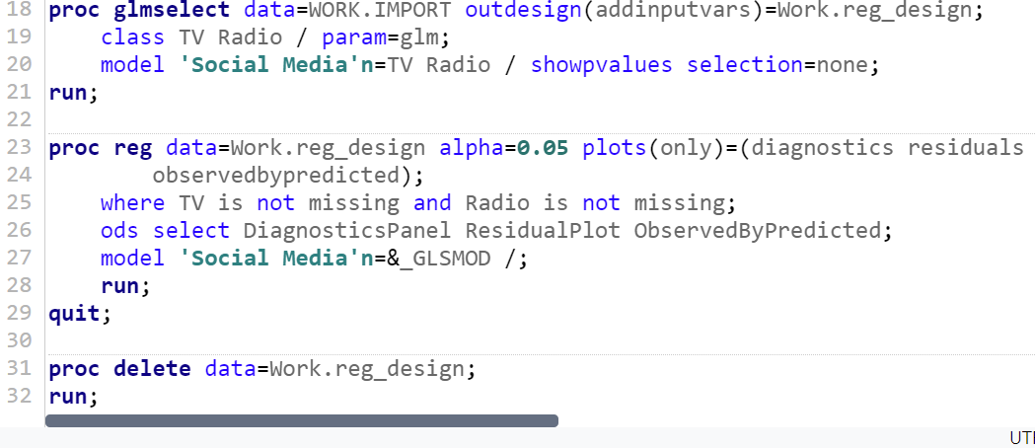
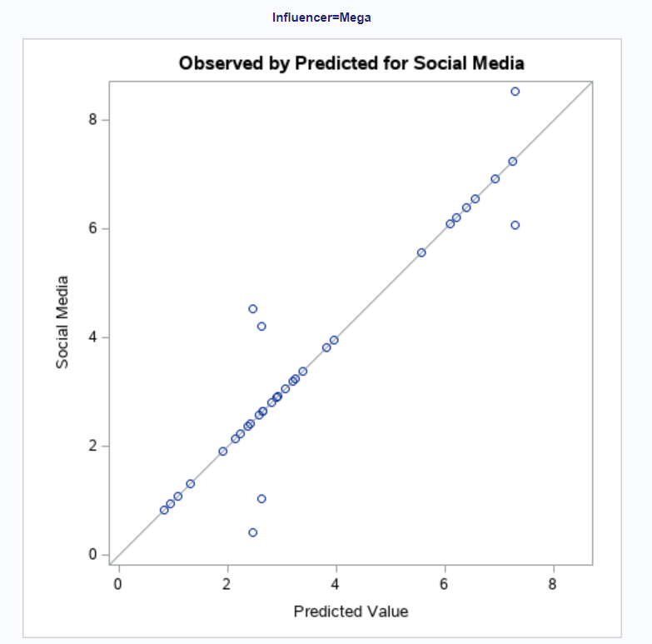
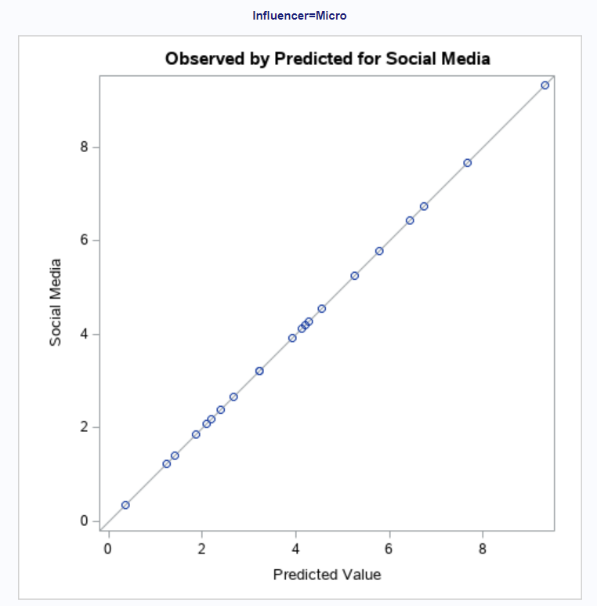
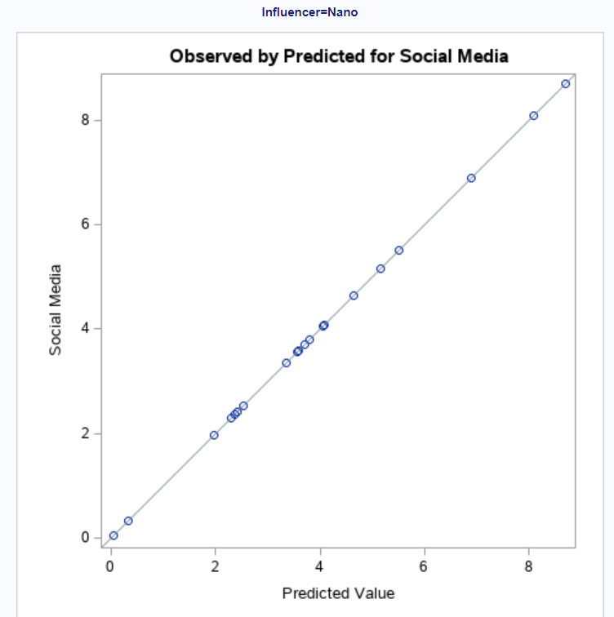
Cont.
Figure 3: Linear Regression Code and Output

Slide 14
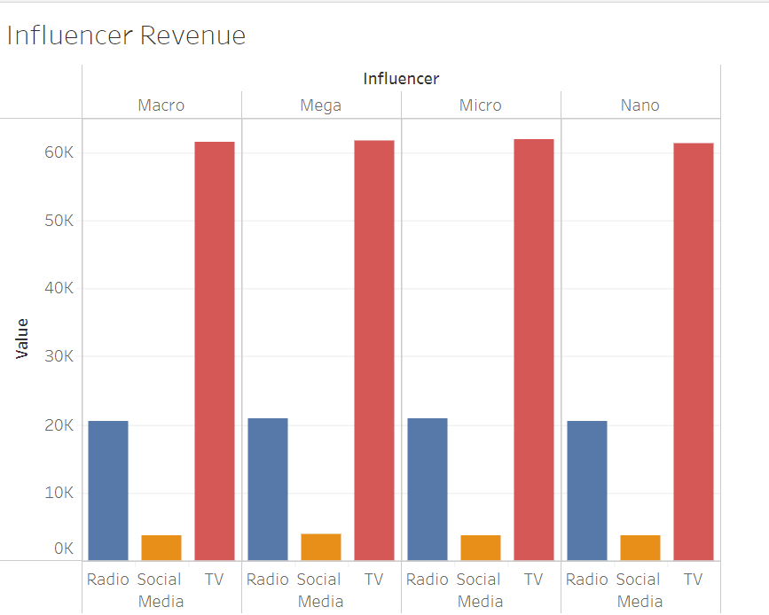
Cont.
Figure 4: Tableau Visualization of Influencer Revenue

Slide 15
Cont.
Figure 4: Tableau Visualization of Influencer Revenue

Slide 18
References
Chugh, R., & Grandhi, S. (2013). Why Business Intelligence?: Significance of Business Intelligence Tools and Integrating BI Governance with Corporate Governance. International Journal of E-Entrepreneurship and Innovation (IJEEI), 4(2), 1-14.
Heinrichs, J. H., & Lim, J. S. (2003). Integrating web-based data mining tools with business models for knowledge management. Decision Support Systems, 35(1), 103–112. doi:10.1016/S0167- 9236(02)00098-2.
SAS. (2022). Retrieved from https://www.sas.com/en_us/home.html
Tableau (2022). Retrieved from https://www.tableau.com/

